Slide 1


Me-312 group project 2023
Prof r. k. mittal
Prof u. k. komal

Slide 2
Analysis and machining
Project presentation

Slide 3
contents
The team
About the chosen project - Introduction
Objective of the project
Theory
About Machines/Equipment used
Observational Infographic
Results
By proceeding further
On the last note

Slide 4
The team
Mooti Meghana (210103071)
Gundeti Srivardhan (210103130)
Rongala Likhita Sai Priya (210103095)
Lolugu Nityasri (210103068)

Slide 5
About the chosen project-Introduction
We chose to work on three work pieces made of same material. Have them machined with different speeds, feeds and depth of cuts on a lathe machine and analyze them.
This analysis includes measuring the surface roughness, form and tolerances of the work pieces.
Out of the three, choosing a workpiece that has smooth surface finish, in-order for us to prepare a hammer head, which brings us to the next part of the project.
With the help of lathe machine again, preparing a machinist hammer whilst taking measurements as per our convenience.

Slide 6
Objective of the project
The main objective of our project is to analyze a specimen made of mild steel using machines such as Profilometer, 3D CMM (Coordinate Measuring Machine) and use the obtained results to find a fitting work piece specimen for the hammer.
To prepare a machinist hammer of mild steel through conventional machining that is by using a lathe machine.
Most importantly, our main aim was to learn how to work with the above machines mentioned, what can we use them for, how to use them and what safety measures to be followed while doing so.

Slide 7
Theory- ANALYSIS

Slide 8
Surface roughness and surface finish
Surface finish refers to the process of altering a metal's surface that involves removing , adding or reshaping. It is a measure of the complete texture of a product's surface that is defined by three characteristics of surface roughness, waviness and lay.
The surface roughness is the total measure of the total spaced irregularities on the surface.
Waviness refers to the warped surface whose spacing is greater than that of the surface roughness length. And lay refers to the direction the predominant surface pattern takes.

Slide 9
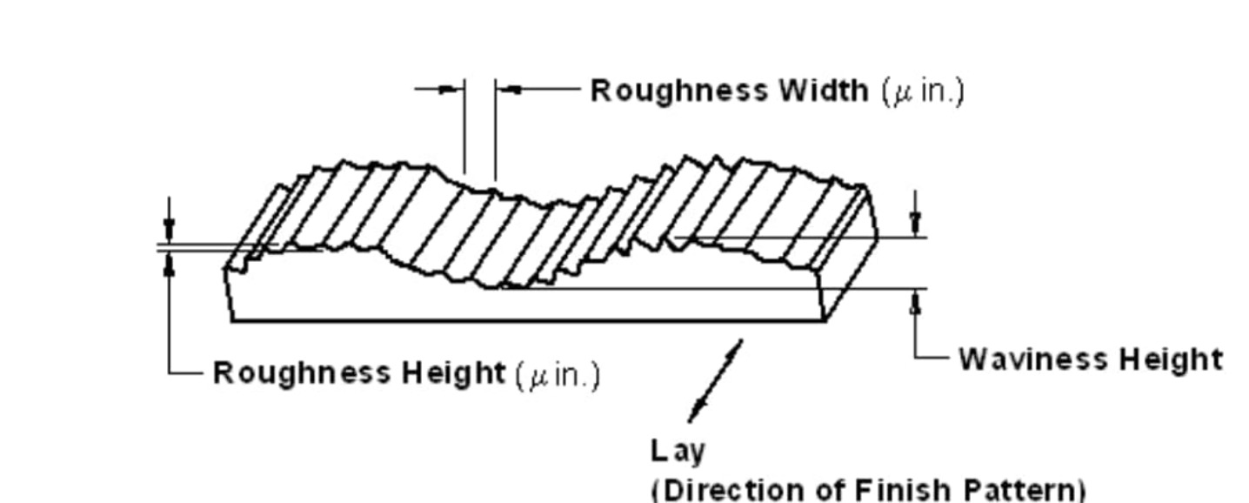
Profile of the surface

Slide 10
ROUGHNESS PARAMETERS
Ra – Average surface roughness
It’s the average roughness between a roughness profile and a mean line. It’s the most-commonly used parameter for surface finish. The Ra surface finish chart is most used because of the absolute values.
Rmax – Vertical distance from peak to valley
This parameter is best used for anomalies such as burrs and scratches. Its sensitive to them.
Rz – Average maximum height of the profile
Unlike Ra, Rz measures the average values of five largest differences between peaks and valleys. It helps eliminate error as Ra is quite sensitive to extremes.
Rq – RMS roughness
Rt – Maximum height of the peak

Slide 11
HOW TO MEASURE SURFACE ROUGHNESS?
There are several measuring systems for surface roughness. They are Direct measurement method, Non-contact method, comparison method, in process methods.
First one includes measurement using a stylus that moves perpendicularly over the surface. Non-contact method involves light or sound instead, where ultrasonic pulse is sent to the surface and the reflected waves are captured.
Comparison techniques employ surface roughness samples that are compared with known parameters and in-process techniques uses inductance.

Slide 12
Non-contact methods
Non-contact methods involve the use of light or sound.
Optical instruments like white light and confocal, replace the stylus. The physical probes can be switched with optical sensors or microscopes.
The instrument used will send an ultrasonic pulse to the surface. Then there will be altering and reflection of sound waves back to the device. You can then assess the reflected waves to determine roughness parameters.
One of the technique to measure it is Profiling technique which involves the measurement using a high-resolution probe.
For which we use a Profilometer.

Slide 13
Geometric tolerances
The two basic types of geometric dimensions utilizing tolerances are:
a) form tolerances
b) positional tolerances
Form tolerances can be applied to a single geometric shape. Positional tolerances are applied those dimensions that are used to locate or position geometric shapes with respect to specified datum planes.
A datum is a feature of a part that acts as a master reference used to locate other features of the part. A datum can be a point, a line, or a plane. Datums are chosen for their functional nature.

Slide 14
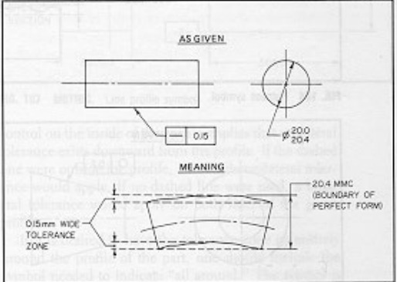
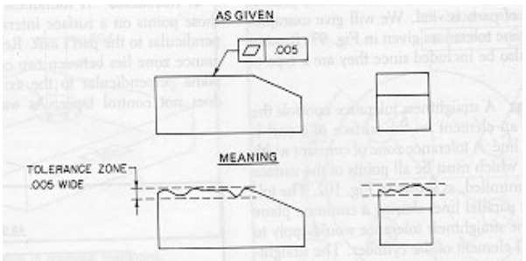
Form tolerances
Straightness:
A surface is straight when all its elements are straight lines.
2. Flatness:
A surface is flat when all its elements are in one plane. Flatness tolerance specifies a tolerance zone between two parallel planes.

Slide 15
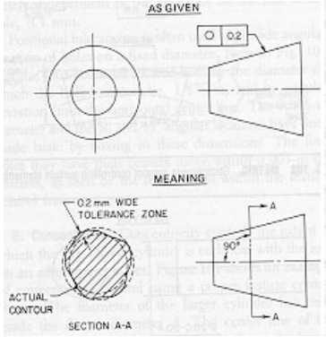
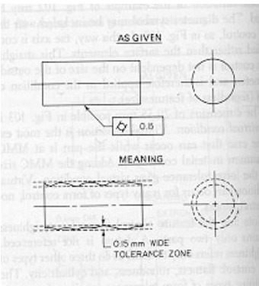
3. Roundness:
A roundness tolerance controls only those points on a surface intersected by any plane perpendicular to the part's axis
4. Cylindricity:
Flatness and cylindricity both involve areas (2D), but the area for cylindricity wraps around a surface.
A cylindricity tolerance defines a tolerance zone consisting of two concentric cylinders.

Slide 16
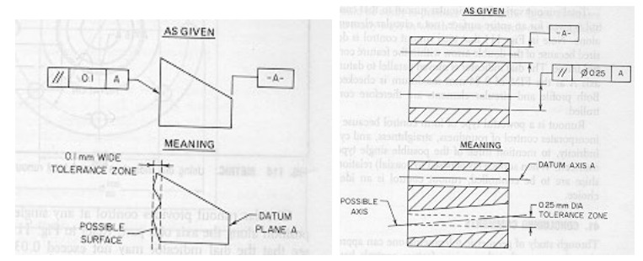
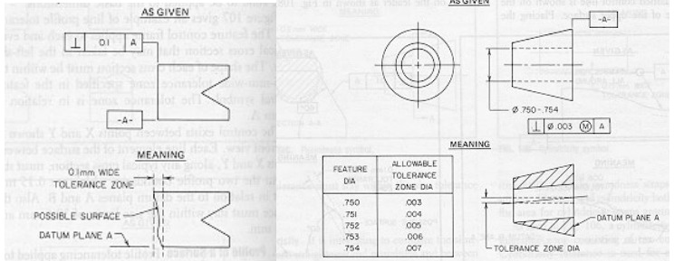
5. Parallelism:
Parallelism exists when a feature is at a constant distance from a datum. The feature could be an axis or a plane, as could be a datum.
6. Perpendicularity:
It can control perpendicularity of a plane with a plane, an axis to a plane, an axis to an axis.

Slide 17
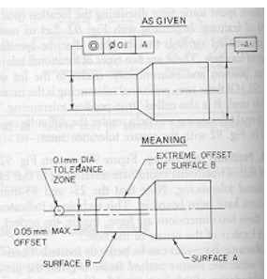
Position tolerances
Concentricity:
Concentricity controls the extent to which the axis of one cylinder is collinear with the axis on an adjoining cylinder.

Slide 18
THEORY- MACHINING

Slide 19
CONVENTIONAL MACHINING
Machining is a metal removing process. It removes a material & decreases the material’s mass hence this is a subtractive process.
Conventional Machining process is a machining process in which the machining is carry out with the traditional method. Which means, not using any advanced method for the machining. There-fore this machining process is also called as traditional machining process.
In this process the sharp point cutting tools are used for the machining purpose, such as the taper tool in the Lathe machine for tapering.
The cutting tool material is harder than the work-piece material & the cutting tool is in directly contact with the workpiece hence more tool wear occurs.
The cutting tool is used against rotary or stationary work-piece for the material removal.

Slide 20
Operations performed on lathe machine
Turning – Straight, Taper and Shoulder 10. Spinning
Chamfering 11. Spring winding
Threading 12. Undercutting
Facing 13. Parting off
Forming 14. Eccentric turning
Filing 15. Reaming
Polishing 16. Boring – Counter and taper
Grooving 17. Drilling
Knurling

Slide 21
Turning: Turning is the operation in which a cylindrical surface is produced.
Tapering: Taper turning is the process of producing external and internal conical surfaces by combining the rotation of the job and the relative angular feed of the tool.
Chamfering: Chamfering is the process of beveling the extreme ends of a workpiece. It is done to remove the burrs, to protect the end of the workpiece from being damaged.
Facing: Facing is an operation used to produce a flat surface at right angles to the rotational axis of the job.
Forming: It is a process in which a convex, concave or irregular surface is formed on the workpiece with the help of a forming tool.
Grooving: The process of creating a narrow slot on the workpiece is called grooving. It is also known as recessing or necking
Knurling: Knurling is the process of embossing a diamond-shaped pattern on the cylindrical surface of a workpiece.
Drilling: Drilling is the process of creating holes, wherever necessary on the workpiece.

Slide 22

MAchines and equipment
And their Literature review

Slide 23
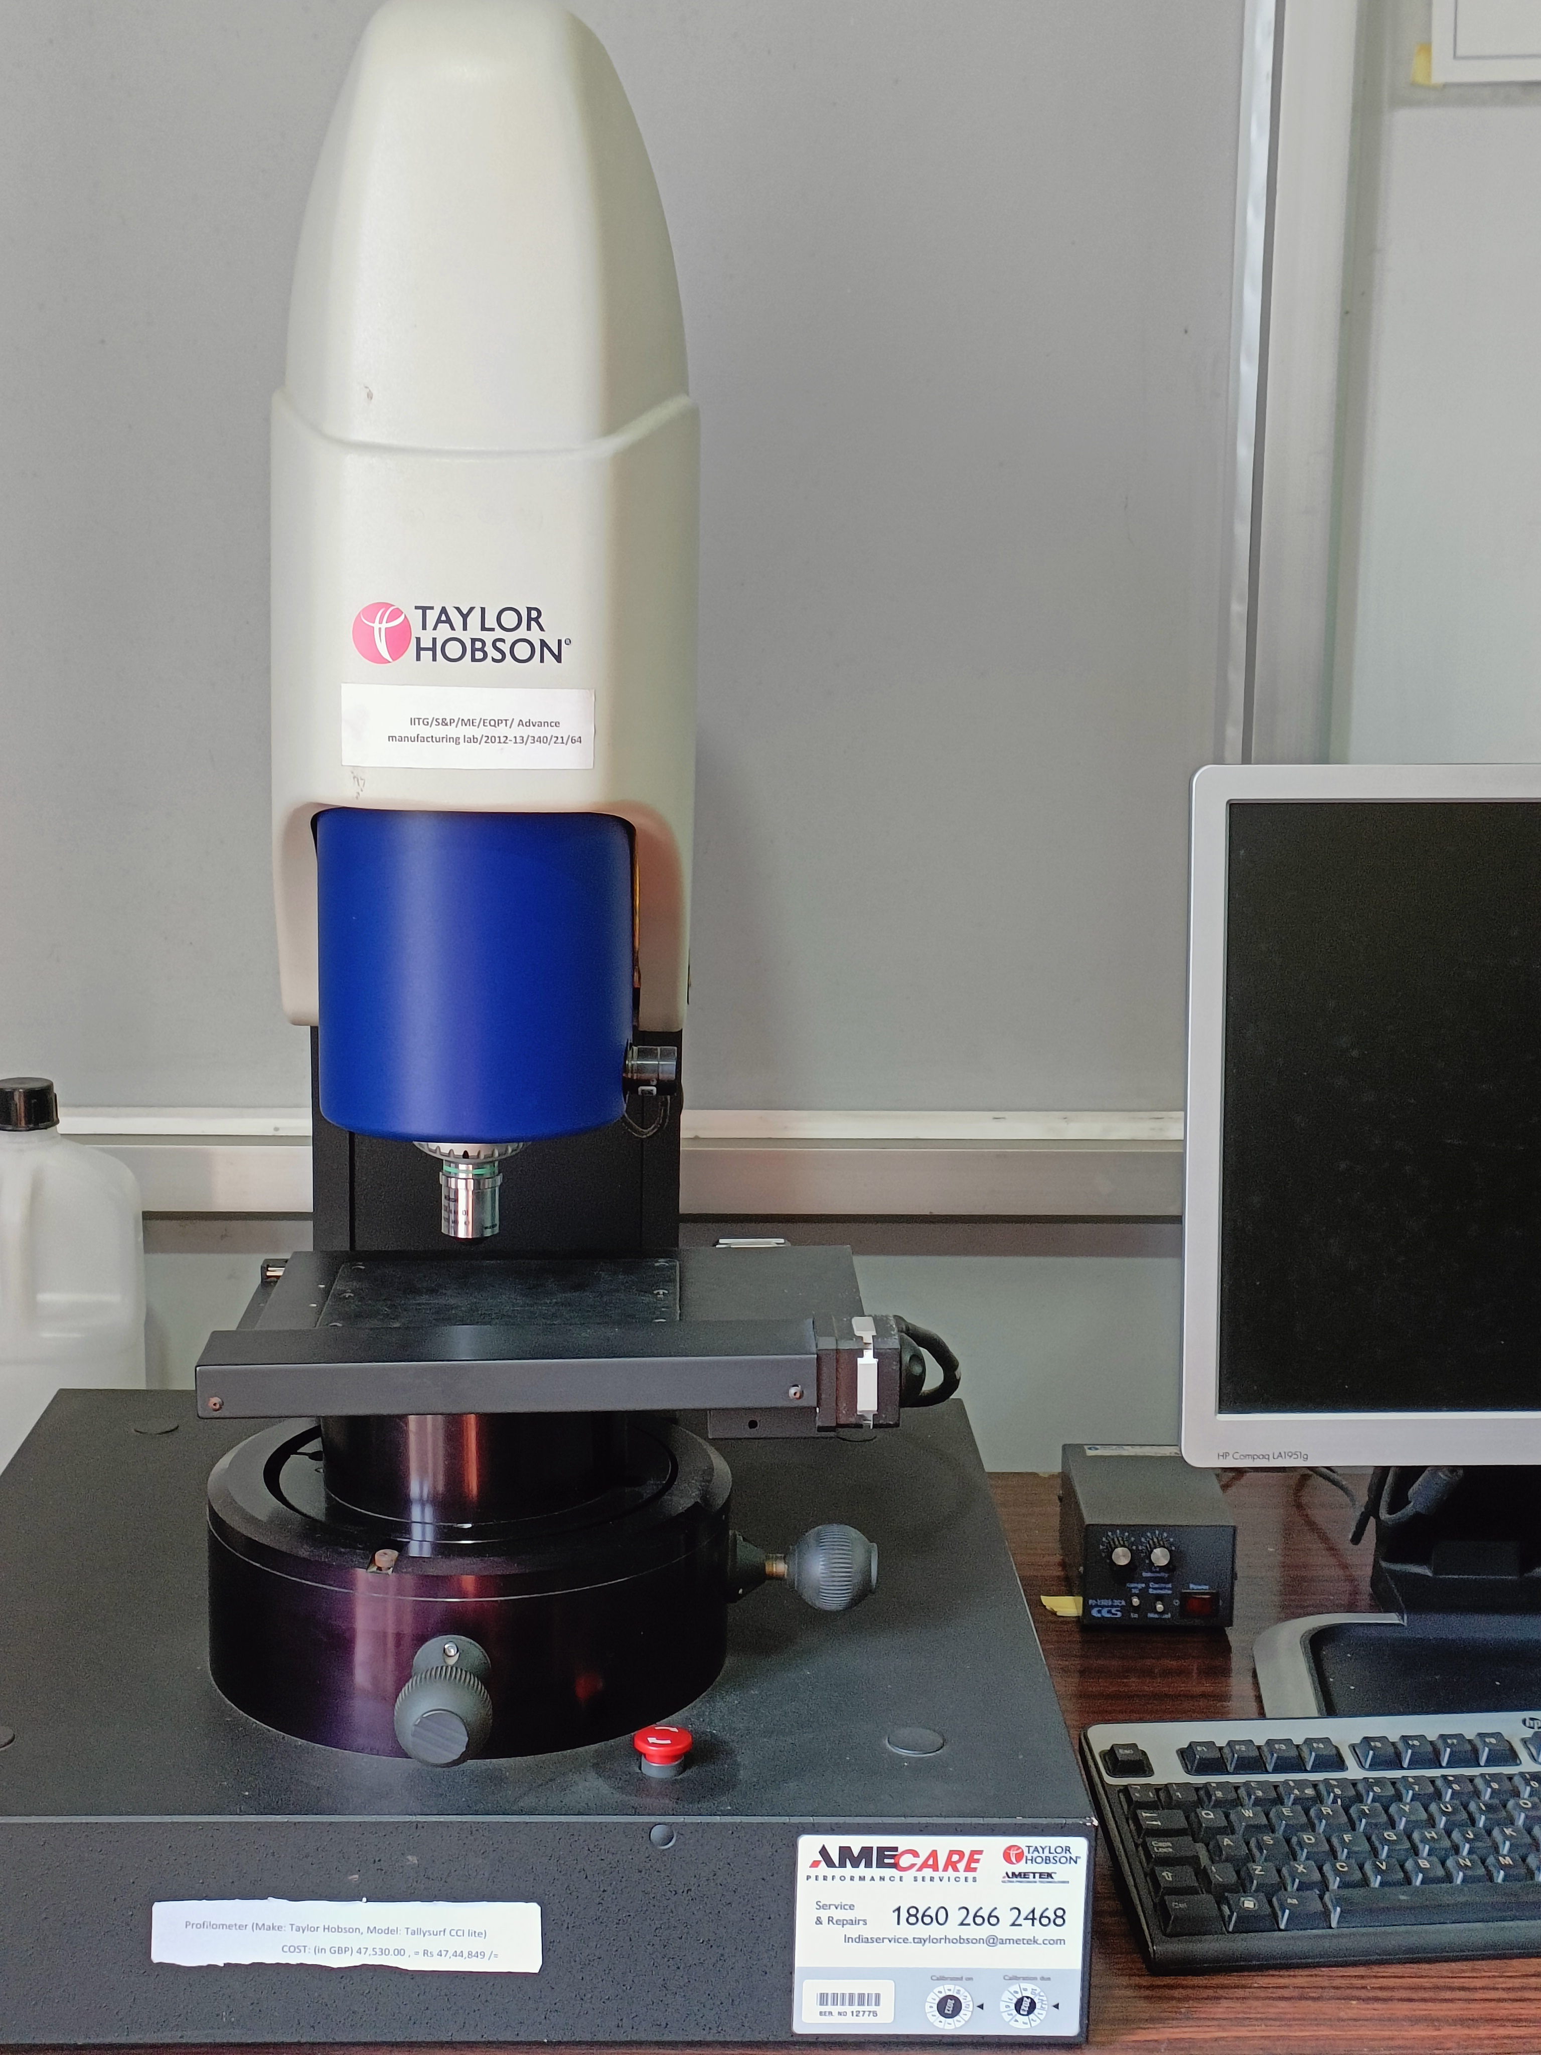
PROFILOMETER
To measure the surface roughness

Slide 24
PROFILOMETER
A profilometer is an instrument used to measure the profile and surface finish of a surface.
On a small scale, surfaces can be composed of a series of peaks and valleys with varying height, depth and spacing. Subtle differences in these features determine if the surfaces feels smooth or rough, looks matte or glossy, can form a seal, or it is suitable for a wear surface.
In industries where mechanical parts are produced, surface finish or surface roughness requirements are commonly specified on technical drawings , and Profilometers used to verify if the requirements have been met.

Slide 25
Types of PROFILOMETERs
Profilometers can be classified into two basic types – Contact and Optical.
Contact profilometers measure surface profile by physically tracing the surface with a stylus.
On contrary, optical profilometers use reflections of various types of light to measure surface features in a line or an area.
The one we opted for, is an Optical type.
Optical profilometer include 1D, 2D and 3D profiling devices.
These devices use Light to measure features on a surface, and their operation can be based on a number of different principles including Optical interference, use of confocal apertures, focus detection and pattern projection.

Slide 26
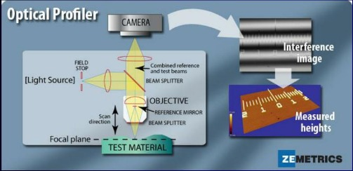
Working principle
A light beam is split, reflecting from the reference (known/flat) and test material.
Constructive and destructive interference occurs.
Forms the dark and light bands known as interference fringes.
The optical path differences are due height variances in the test surface.
Constructive interference areas are lighter where are the other is darker.
Light to dark fringes represents one-half a wavelength of difference between the reference path and the test path.
Reference: PPT - Dept. of Mechanical Engineering, IISc PowerPoint Presentation, free download - ID:1454391 (slideserve.com)

Slide 27
OPTICAL PROFILOMETERS
Optical profilometers are relatively large instruments that consist of a light source, optical lenses, and image sensors.
They require the surface to reflect the light being used, so many of these instruments will have trouble measuring translucent or highly reflective surfaces. Also, for the reflection to accurately characterize the surface, it must be free of debris and contaminants such as dirt, water, and oil.
Since light travels very quickly, measurements can be taken faster than with contact profilometers. With some instruments, millions of readings can be collected in seconds, making it practical to model a relatively large area’s surface topography.
There is no stylus tip, hence it has no wearing of the tip whatsoever.

Slide 28
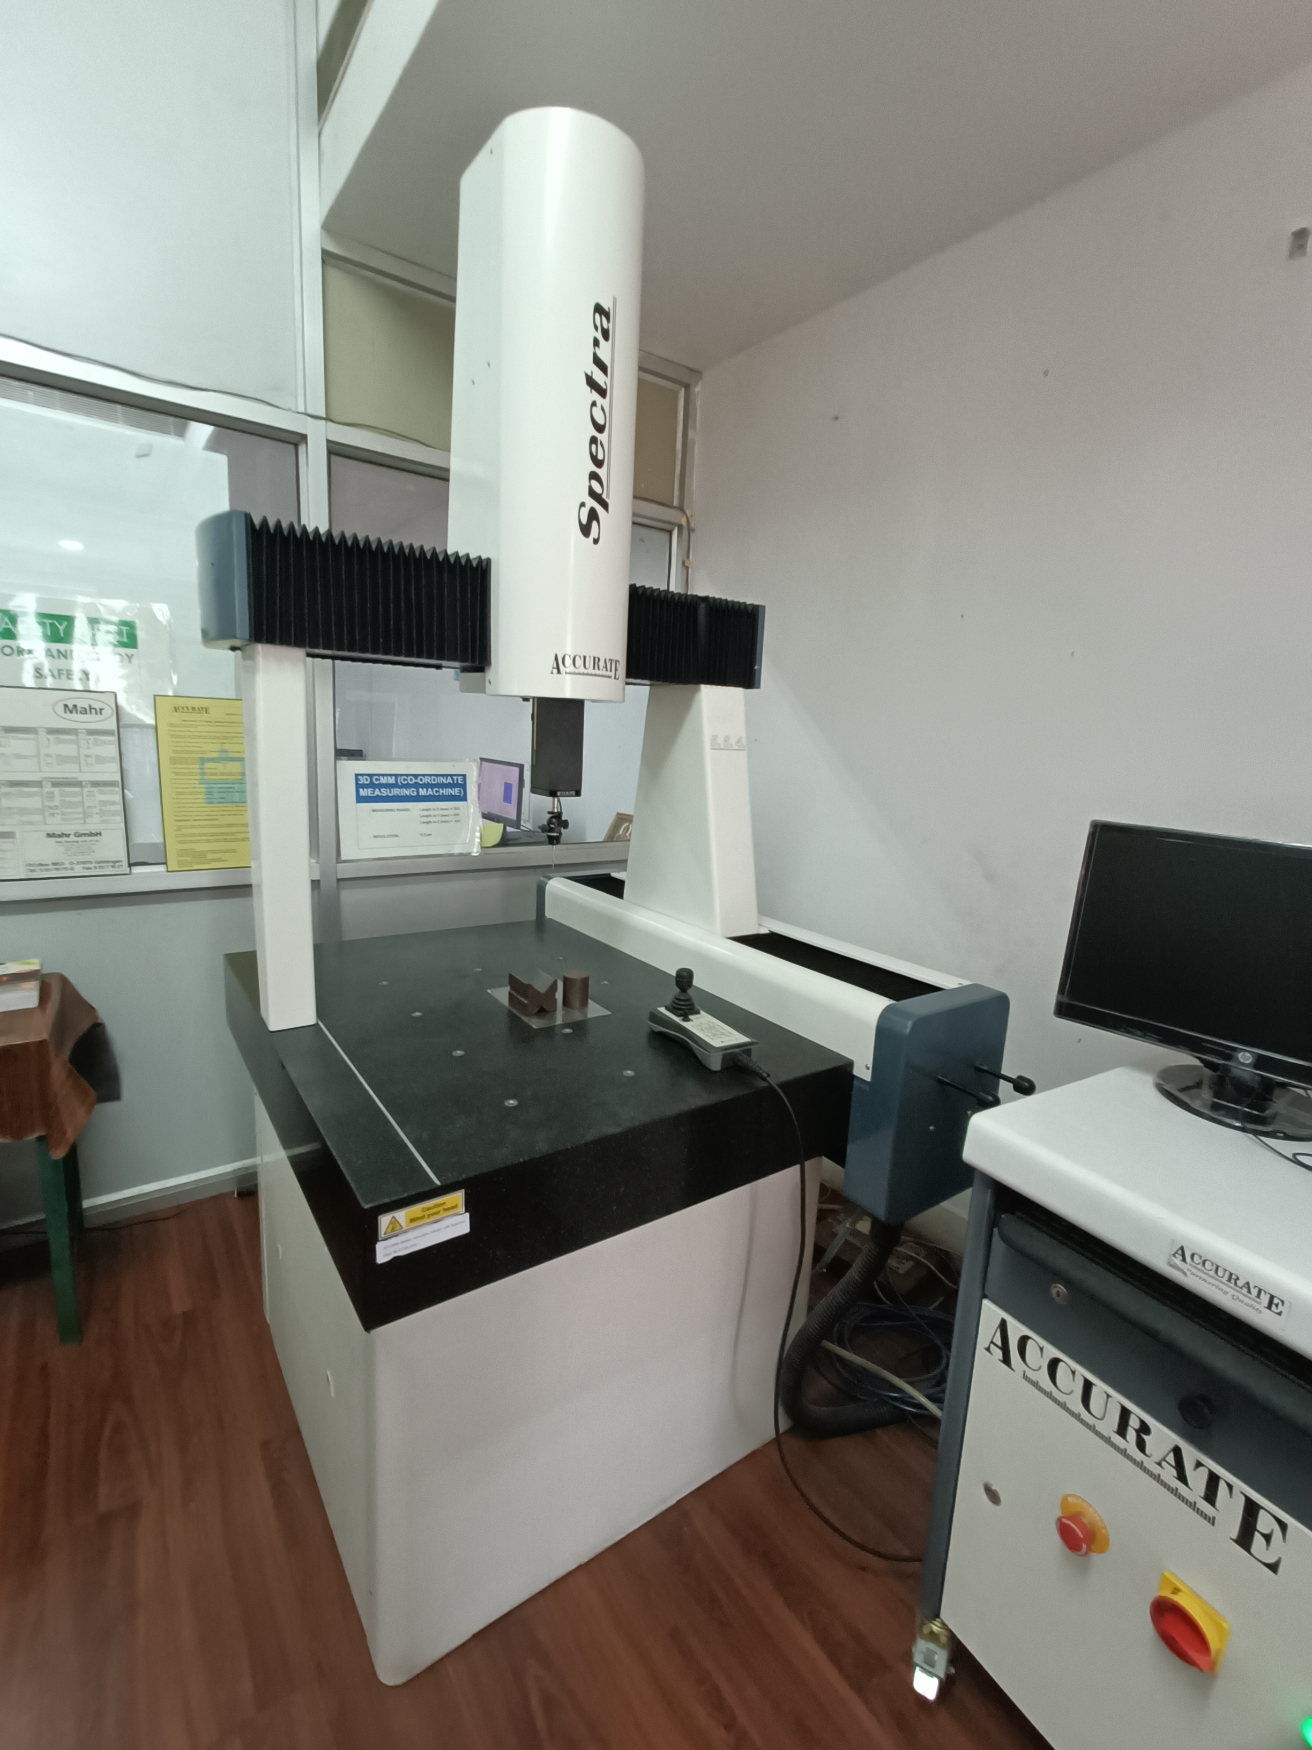
3D CMM (CO-ORDINATE MEASURING MACHINE)
TO MEASURE GEOMETRIC TOLERANCES

Slide 29
3D CMM
A coordinate measuring machine (CMM) is a device that measures the geometry of physical objects by sensing discrete points on the surface of the object with a probe.
CMMs typically specify a probe's position in terms of its displacement from a reference position in a three-dimensional Cartesian Co-ordinate system (i.e., with XYZ axes).
The typical 3D "bridge" CMM allows probe movement along three axes, X, Y and Z, which are orthogonal to each other in a three-dimensional Cartesian coordinate system.

Slide 30
Each axis has a sensor that monitors the position of the probe on that axis, with typical accuracy in the order of microns.
When the probe contacts (or otherwise detects) a particular location on the object, the machine samples the axis position sensors, thus measuring the location of one point on the object's surface, as well as the 3-dimensional vector of the measurement taken.
This process is repeated as necessary, moving the probe each time, to produce a "point cloud" which describes the surface areas of interest. The points can be measured either manually by an operator or automatically via Direct Computer Control (DCC) or automatically using scripted programs; thus, an automated CMM is a specialized form of industrial robot.
A common use of CMMs is in manufacturing and assembly processes to test a part or assembly against the design intent. The measured points can be used to verify the distance between features. They can also be used to construct geometric features such as cylinders and planes etc. for GD&T such as roundness, flatness and perpendicularity can be assessed.

Slide 31
Parts of a 3d Cmm
Coordinate-measuring machines include three main components:
The main structure includes three axes of motion. The material used to construct the moving frame has varied over the years. Today all the major CMM manufacturers build frames from Granite, aluminum alloy or some derivative and, also use ceramic to increase the stiffness of the Z axis for scanning applications. The increasing trend towards scanning also requires the CMM Z axis to be stiffer and new materials have been introduced such as black granite, ceramic and silicon carbide.
Probing system- Which has a ruby ball as it's stylus tip.
Data collection and reduction system — typically includes a machine controller, desktop computer and application software.

Slide 32
Working and uses
The CMM uses a probe to measure the physical characteristics of a dimensional surface. The probe moves along three axes to determine an object's spatial displacement. The sensors on each axis monitor the probe's location to program the points on the surface.
A coordinate measuring machine is used during product development, designing, engineering, and other processes within manufacturing.
Accurate data reduces iterations and eliminates variances in final products. The data collected by 3D measurement technology is so precise that the goods produced in batch manufacturing have fewer differences overall.
A significant difference between a traditional CMM and a 3D scanner is the coordinate measuring machine uses a touch probe. In contrast, a scanner measures points and collects data without ever physically touching the object's surface.

Slide 33
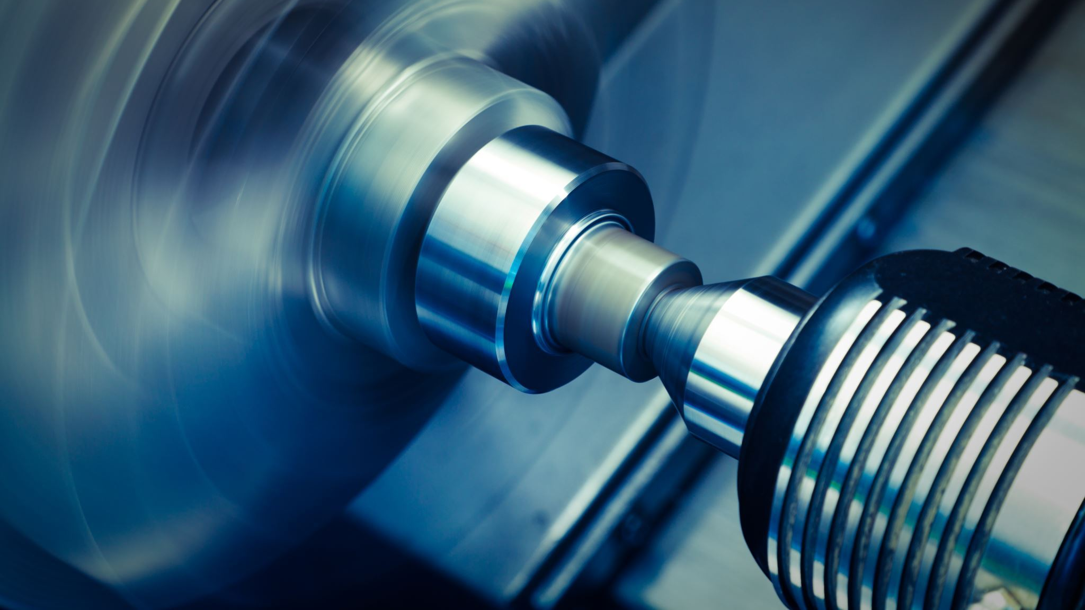
Lathe machine
Used for machining processes

Slide 34
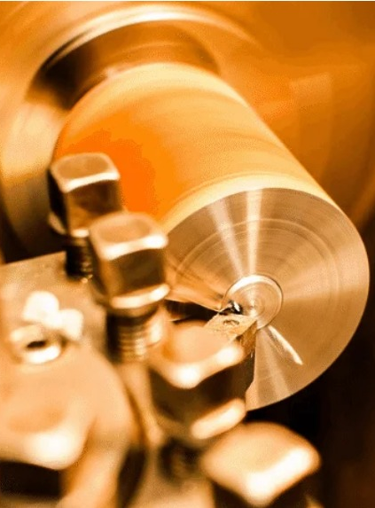
LATHE MACHINE and it's uses
The elimination of parts of a metal from the workpiece is referred to as Machining.
The process essentially involves a range of manufacturing operational processes which can include boring holes into pieces of material, shaping materials, drilling holes, cutting through materials, reaming, grinding and much more. A popular tool used in the machining process is the lathe machine.
The machine tool that is used to remove unwanted metals from the workpiece to give the desired shape and size is thus called a Lathe machine.
The material that needs to be machined is clamped firmly and made to revolve on an axis as it is being bent, drilled or engraved.

Slide 35
Types of lathe
Wood turning lathe * Special purposes lathe:
Speed lathe Jeweler's lathe
Centre lathe or engine lathe Crank shaft turning lathe
Gap bed lathe Wheel lathe
Tool room lathe Copy lathe
Bench lathe * Automatic lathe
Hollow spindle lathe * CNC lathe
Turret and Capstan lathes
Vertical turret lathe

Slide 36
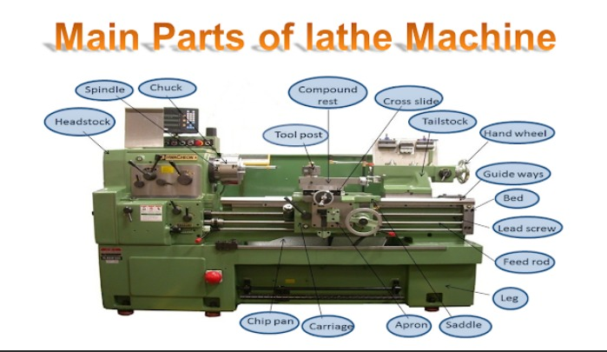
PARTS OF A LATHE MACHINE
The lathe stand/ legs
Headstock * Tool post
Spindle * Apron
Gearbox * Bed
Chuck * Way
Tailstock * Lead screw
Carriage
Saddle
Traverse slide
Composite glide
Ref: Lathe Machine : Definition, Parts, Types & Operations - MechanicsTips

Slide 37
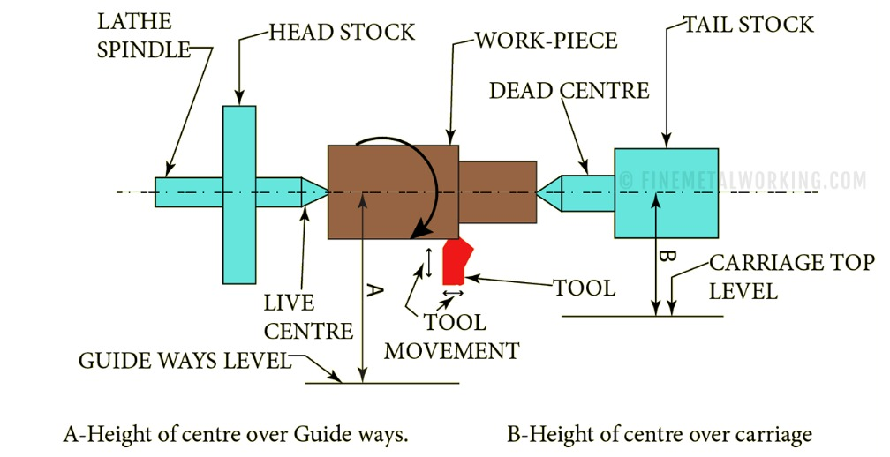
WORKING PRINCIPLE
Major specifications of your lathe are, the maximum distance between the live and dead center and the height of the center over the guideways and carriage.
The first one indicates the maximum length of work which you can turn and the second one (A and B in the sketch) indicates the maximum diameter which you can swing/ revolve safely over the guideways and carriage.
Ref: Lathe Machine: Types of Lathes and Uses (finemetalworking.com)

Slide 38
OBSERVATIONAL INFOGRAPHIC

Slide 39
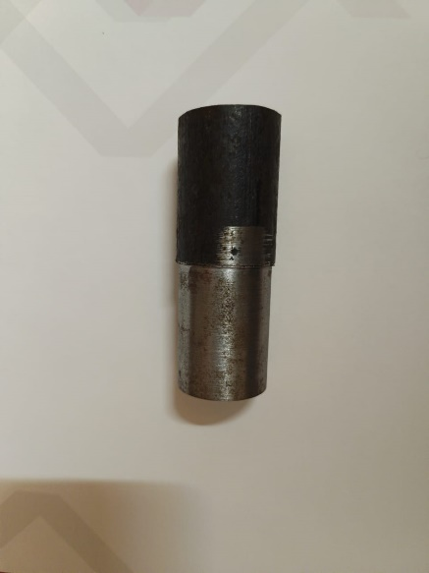
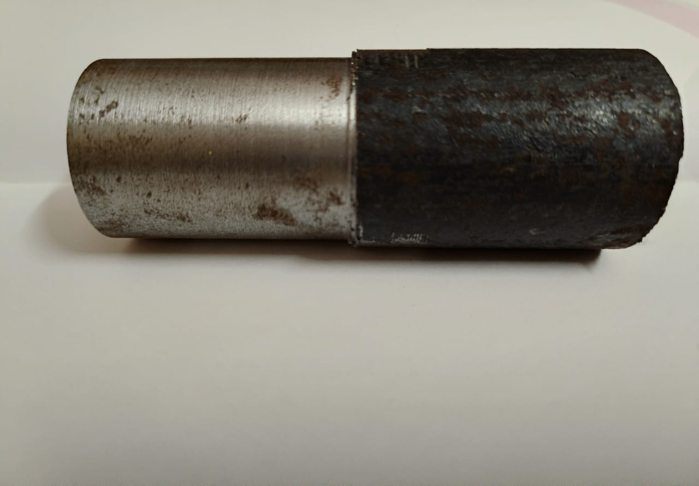
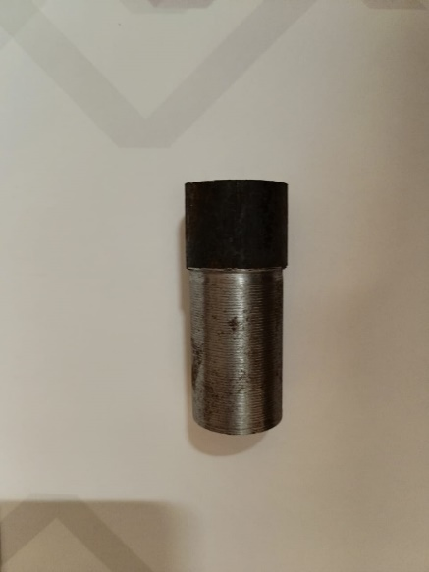
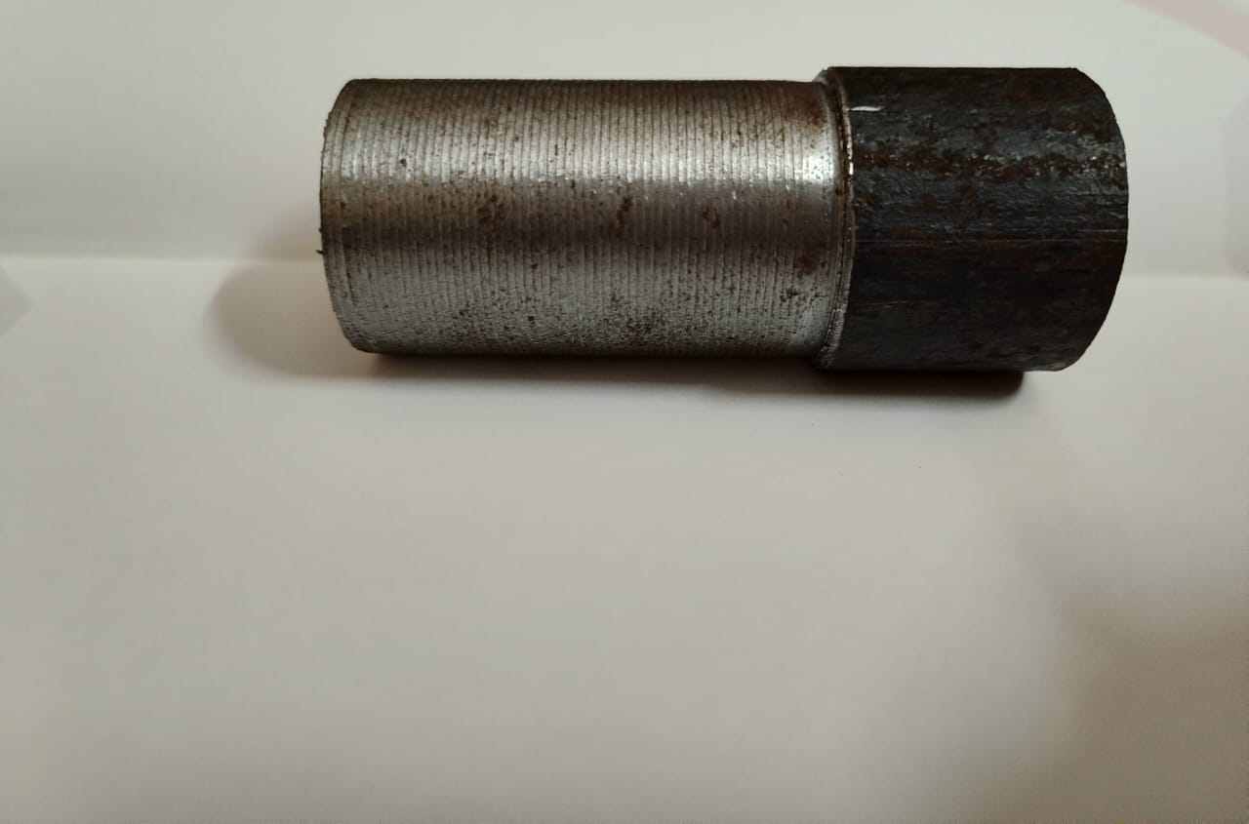
About the workpieces
Workpiece material: Mild steel
Number of specimens: 3
Number of Specimens used for analysis: 2
Job 1 is machined with a depth of cut of 0.5mm, 384 RPM and a feed of 0.058mm. Whereas Job 2 has 0.4mm, 288 RPM and 0.8mm as its depth of cut, speed and feed respectively.
Job 3 is made with a depth of cut of 0.6mm, 598 RPM and a feed of 0.187mm.
The figures depict the top and side views of our specimens, Job 1 and 3, in the order.

Slide 40
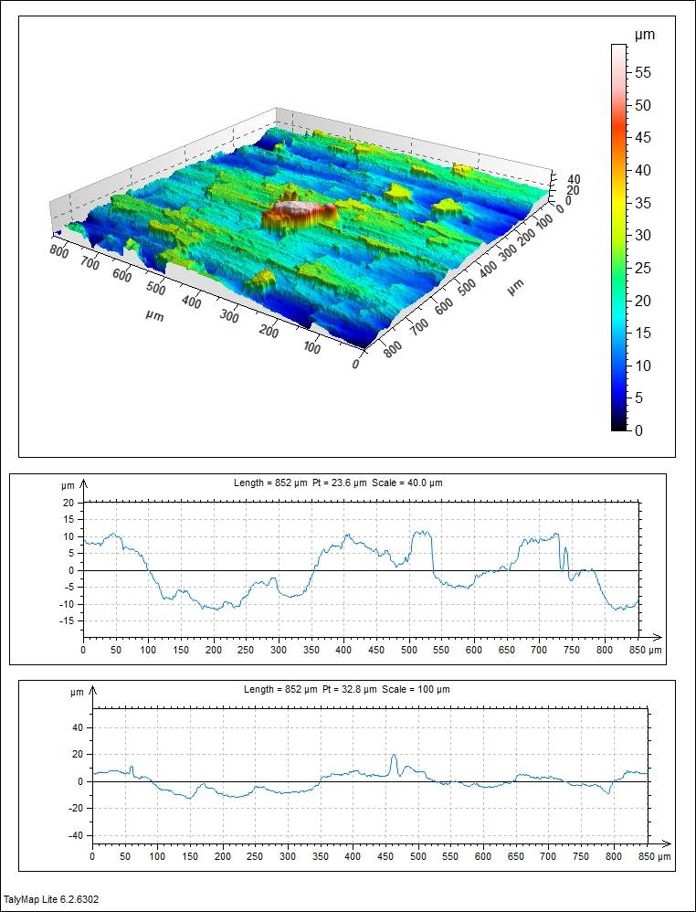
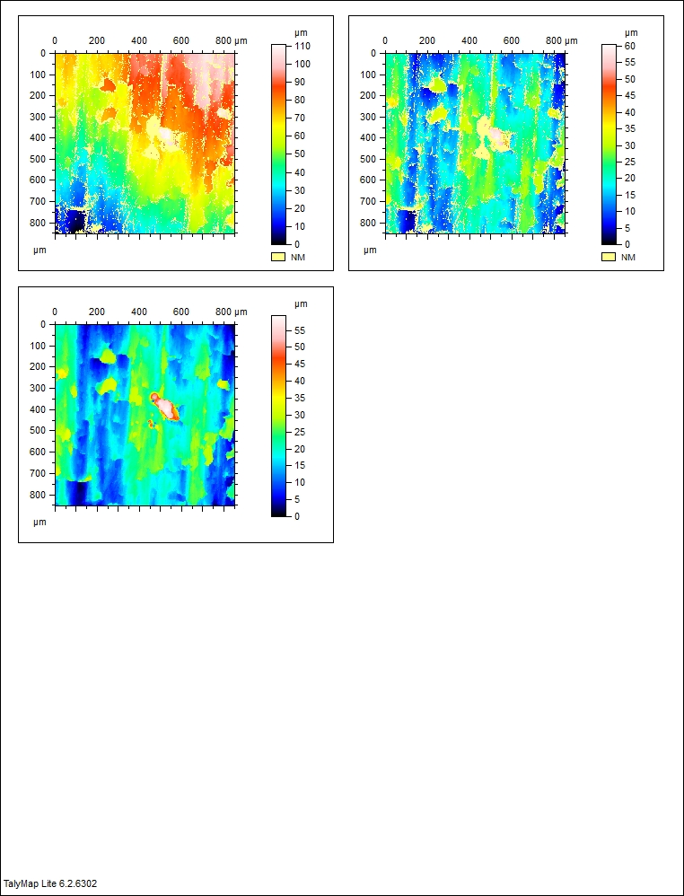
Microscopic view of surface roughness
Job no: 1
Depth of cut: 0.5 mm
RPM: 384
Feed: 0.058mm

Slide 41
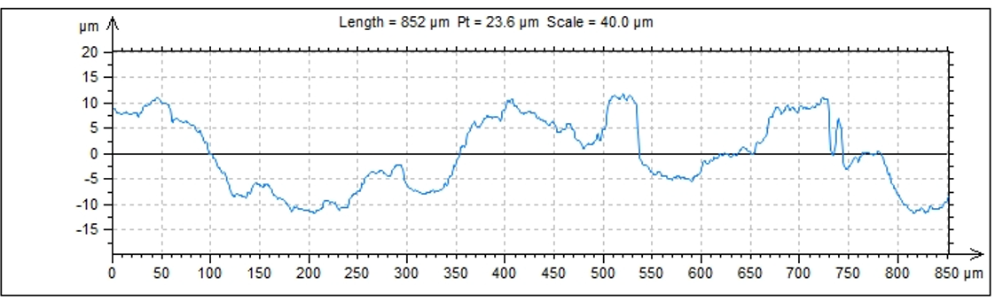
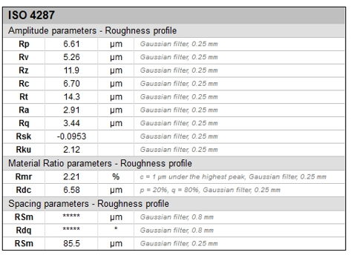
THE ROUGHNESS PROFILE AT THE TOP SECTION

Slide 42
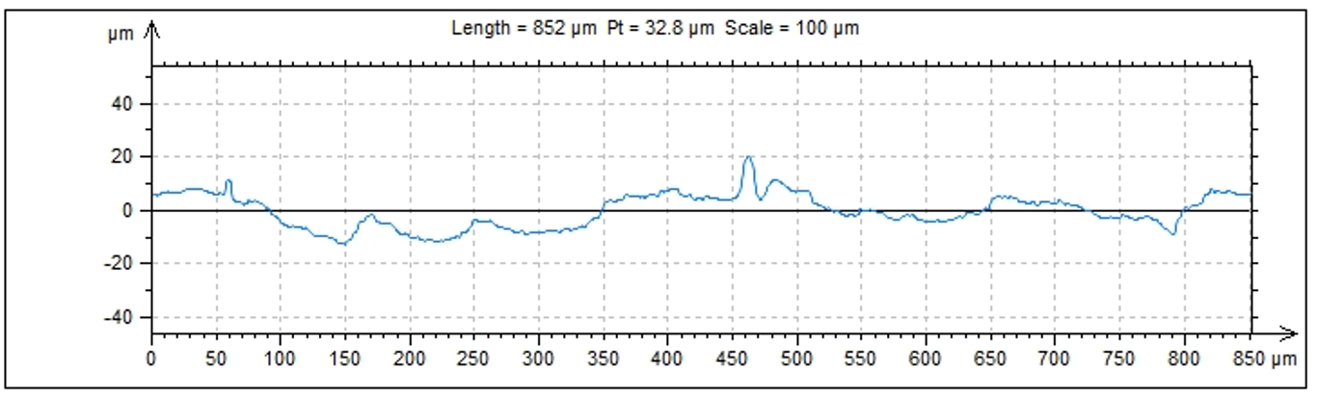
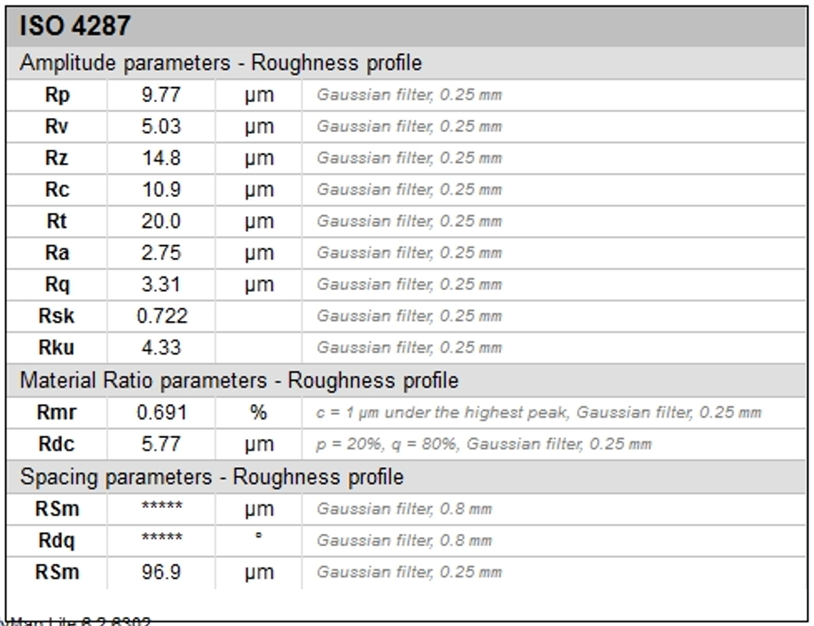
The roughness profile of the mid-section

Slide 43
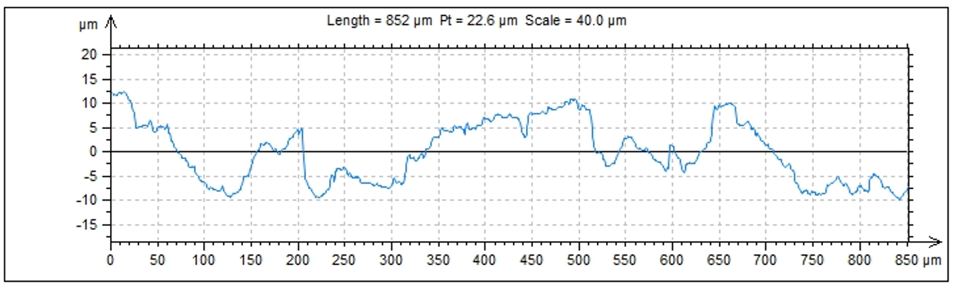
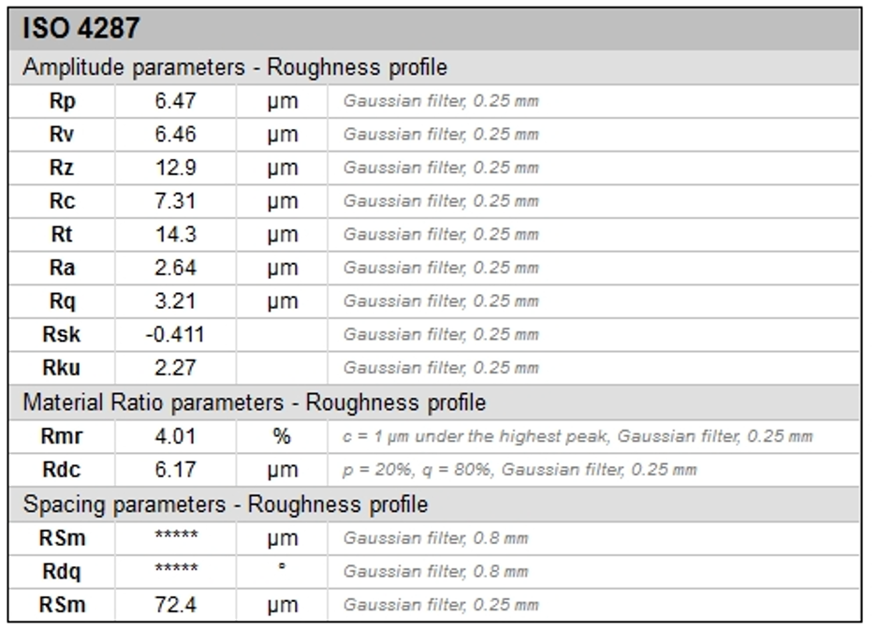
The roughness profile of the bottom section

Slide 44
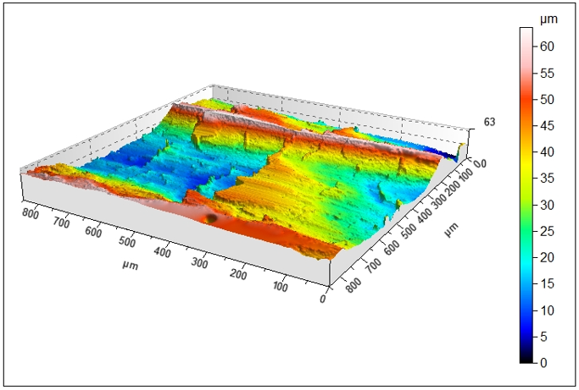
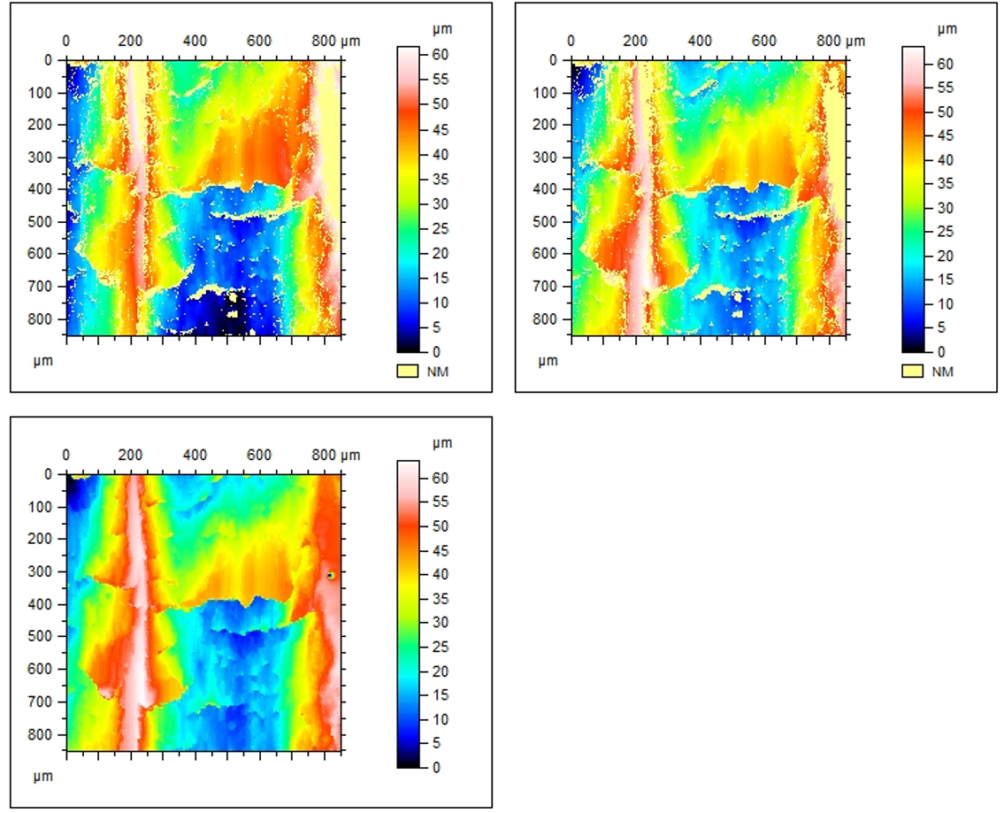
Microscopic view of surface roughness
Job no: 3
Depth of cut: 0.6 mm
RPM: 598
Feed: 0.187 mm

Slide 45
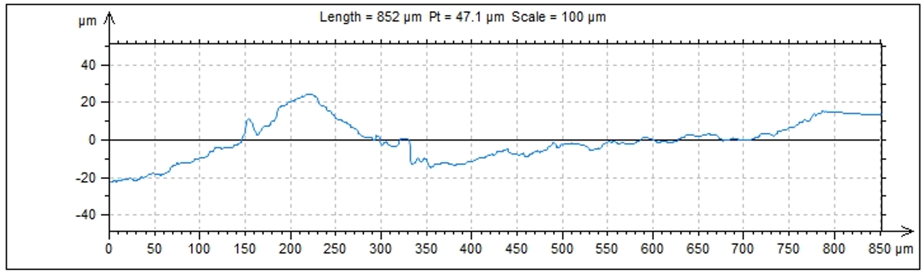
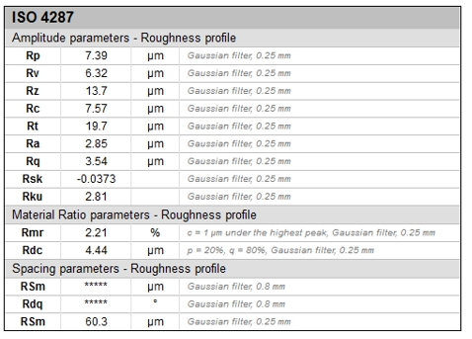
The roughness profile at the top section

Slide 46
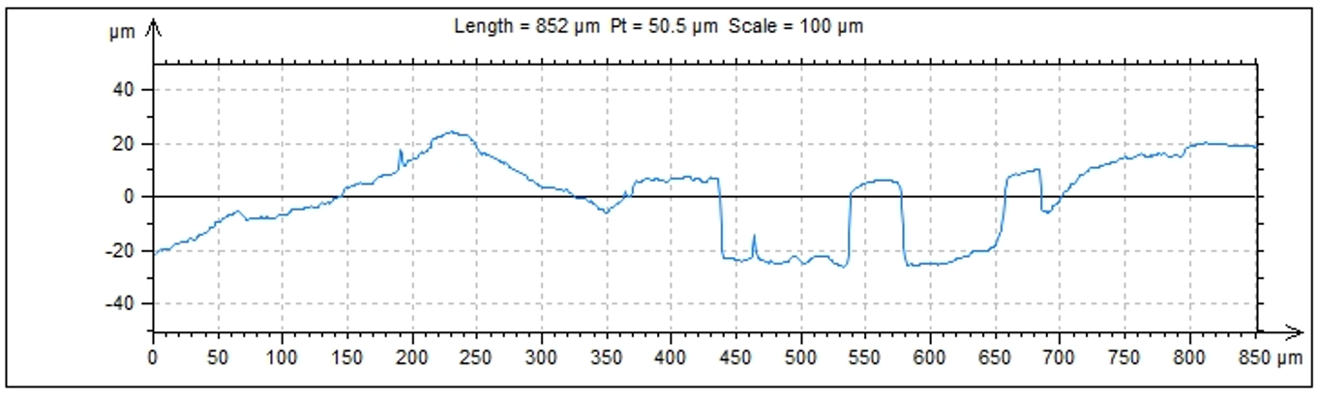
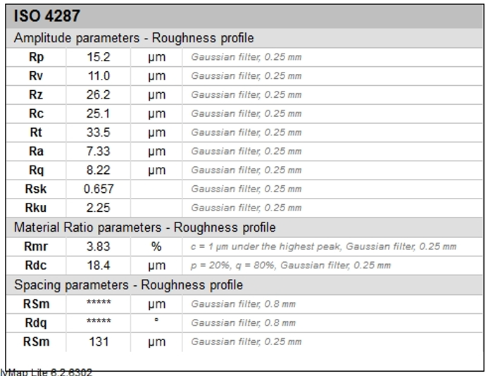
The roughness profile of the mid- section

Slide 47
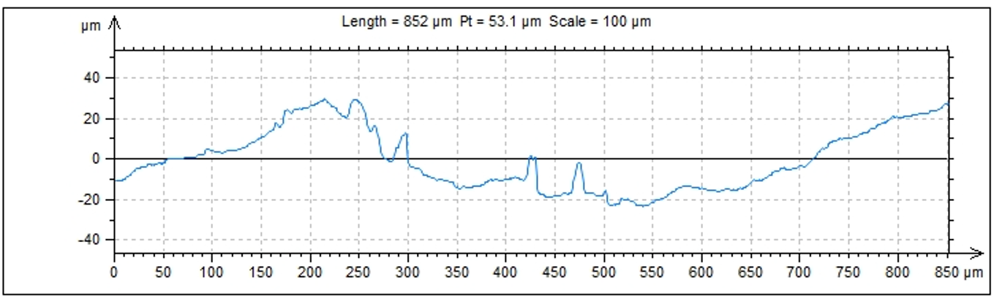
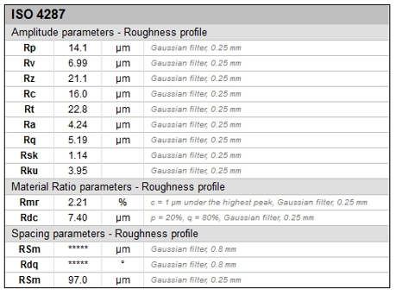
The roughness profile of the bottom section

Slide 48
Parameters observed using 3DCMM
For job 1
1. Flatness: 5. Diameter: 8. Concentricity:
Plane-1: 0.0085 mm Circle-1: 28.0767 mm Vertical Cylinders: 3,4
Plane-2: 0.0271 mm Circle-2: 28.0618 mm Datum Cylinder : 3
2. Circularity: Cylinder-1: 28.0999 mm Cylinder-4 w.r.t Cylinder-3: 1.7405 mm
Circle-1: 0.0143 mm Cylinder-2: 28.1128 mm
Circle-2: 0.0216 mm 6. Perpendicularity ( Datum: PL-5)
3. Cylindricity: Line 1 w.r.t Plane-5: 0.0374 mm
Cylinder-1: 0.02 mm Line 2 w.r.t Plane-5: 0.2001 mm
Cylinder-2: 0.1127 mm Line 3 w.r.t Plane-5: 0.0486 mm
4. Straightness: 7. Parallelism :
Line-1: 0.1082 mm Line-1 w.r.t Line-2: 0.0227 mm
Line-2: 0.0464 mm Line-2 w.r.t Line-2: 0 mm
Line-3: 0.0353 mm Line-3 w.r.t Line-2: 0.1728 mm

Slide 49
Parameters observed using 3DCMM
For job 3
1. Flatness: 5. Diameter: 8. Concentricity :
Plane-1: 0.0087 mm Circle-1: 27.8525 mm Vertical Cylinders: 8,9
Plane-2: 0.0034 mm Circle-2: 27.8922 mm Datum Cylinder: 8
2. Circularity : Cylinder-1: 27.895 mm Cylinder-9 w.r.t Cylinder-8: 0.1199 mm
Circle-1: 0.0562 mm Cylinder-2: 28.032 mm
Circle-2: 0.0215 mm 6. Perpendicularity ( Datum: Pl-3)
3. Cylindricity: Line 1 w.r.t Plane-3: 0.8334 mm
Cylinder-1: 0.0288 mm Line 2 w.r.t Plane-3: 0.2307 mm
Cylinder-2: 0.005 mm Line 3 w.r.t Plane-3: 0.2665 mm
4. Straightness: 7. Parallelism : (max deviation limit)
Line-1: 0.1045 mm (max value) Line-1 w.r.t Line-2: 0.6923 mm
Line-2: 0.1098 mm Line-2 w.r.t Line-2: 0 mm
Line-3: 0.0583 mm Line-3 w.r.t Line-2: 0.0375 mm

Slide 50
Results
Hereby one can assume the suitable workpiece required for proceeding further. All it needs to have is a better surface finish and low surface roughness. The analysis, however, proves us just that.
Low surface roughness and tolerances within the allowable range can help us decide which workpiece makes a better base specimen to proceed further with our work.
Although a high surface roughness means better grip, it can be decided according to the requirement of the object to be manufactured or machined. It should also be within a range where it doesn’t cause fatigue failure during work time.
However in our case it’s better if our piece has a smooth surface. And Job number 2 has good parameters overall. And it can now be proceeded to make a hammer.

Slide 51
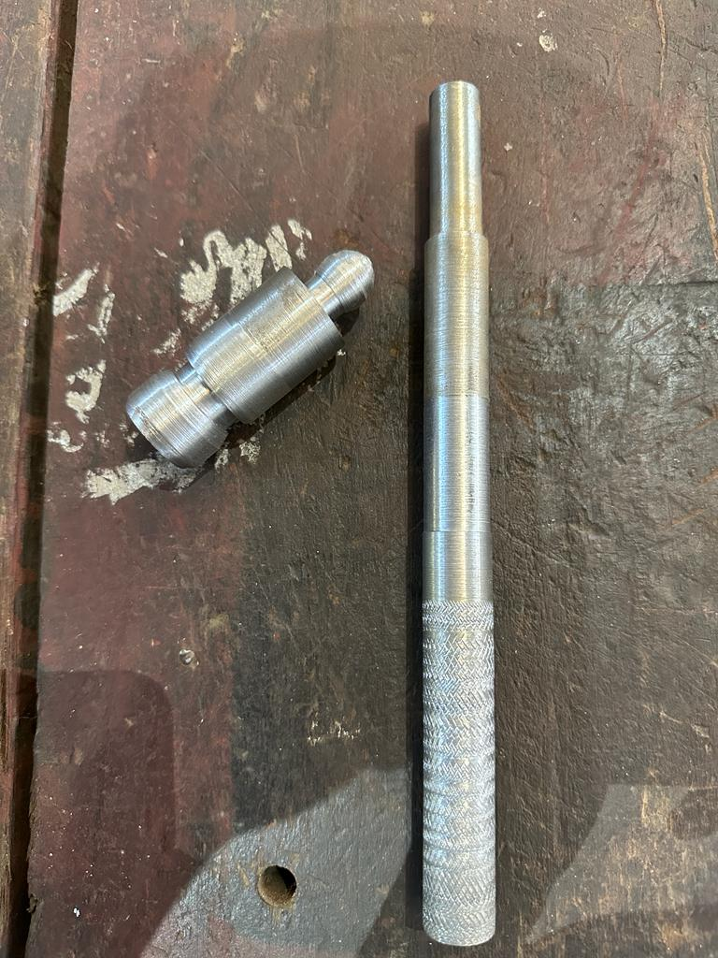
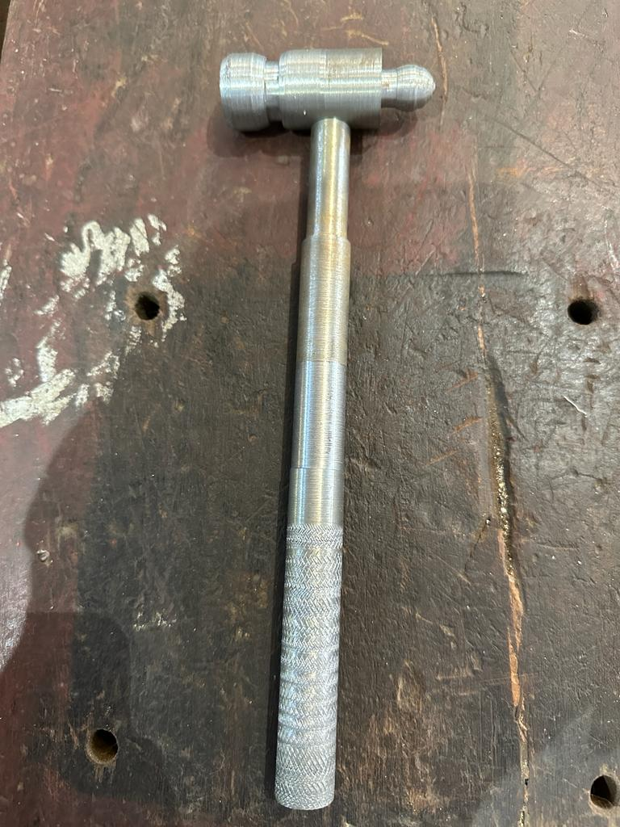
BY PROCEEDING FURTHER
The smoothest of the three was chosen to prepare a machinist hammer. Although our initial plan was to carry out only the machining process, we were, however, convinced to do the analysis part as well as the machining part.
The dimensions of the hammer were as per our convenience and were carried out on a lathe machine. The process included turning, knurling, chamfering, forming, grooving etc.

Slide 52
On the last note…
This brings us to the end of our project. We got to learn about the usage of different equipment and machines and how to use them, as well as the dos and don’ts.
We learnt how a parameter such as surface roughness that’s undermined in general, affects a workpiece in great deal.
Through it all we were able to witness the change in the profiles, it’s something that can be only seen through special equipment and not naked eyes, which gives us much more of a reason to be careful.
The better the surface finish, the better the manufactured part.

Slide 53
References
What is a Profilometer? | GD&T Basics (gdandtbasics.com) About profilometer.
Surface Roughness Chart: Understanding Surface Finishes | RapidDirect About surace roughness and surface finish.
TOLERANCES OF FORM AND POSITION (GEOMETRICAL TOLERANCES) (mehmetaladag.com) About different tolerances.
Conventional machining process: Definition, Advantages, Limitations [with Pdf] (mechcontent.com) Conventional machining.
25 Basic Operations Performed On Lathe Machine (learnmech.com) Operations on lathe.
Coordinate-measuring machine - Wikipedia 3D CMM

Slide 54
Thank you

